Slide 1
BRITISH AIRWAYS
PREDICTING CUSTOMER BUYER BEHAVIOUR

Slide 2
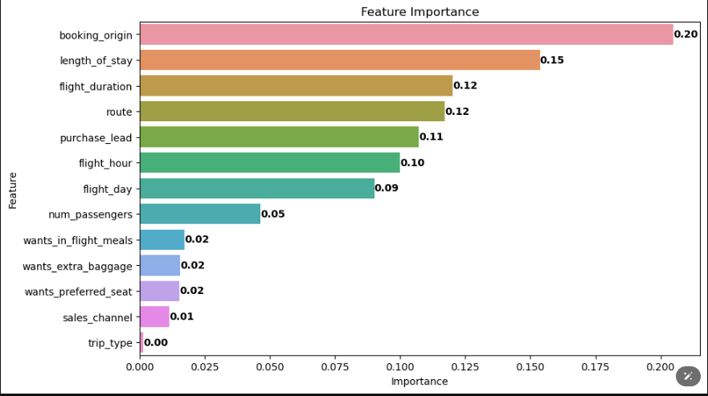
predictive model to understand factors that influence buying behaviour
We then re-trained the model based on feature importance which includes seven column and we had:
ACCURACY: 0.91
AUC score: 0.93
Route
Booking_origin
Flight_duration
Flight_hour
Length_of_stay
Flight_day
Purchase_lead
are the top six important features which
helps to better predict
Customer buying behavior

